Slide 1


Yolanda Chen
Aug 6 2025

Slide 2

Predicting Falcon 9 First Stage Landing Success
Executive Summary
Introduction
Methodology
Results
Conclusion
Appendix

Slide 3
Executive Summary
Summary of methodologies
Summary of all results

Slide 4
Introduction
Problems you want to find answers:
Can we reliably predict if Falcon 9's first stage will land successfully based on historical launch data?
Describe the pain points of competing startups requiring low-cost rocket launches and explain the impact of predicting successful landings on bidding strategies.

Slide 5
Methodology
Executive Summary
Data collection methodology:
Describe how data was collected
Perform data wrangling
Describe how data was processed
Perform exploratory data analysis (EDA) using visualization and SQL
Perform interactive visual analytics using Folium and Plotly Dash
Perform predictive analysis using classification models
How to build, tune, evaluate classification models

Slide 6
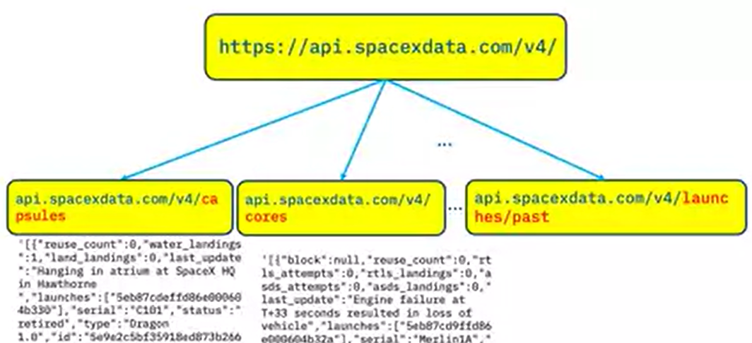
Data Collection – SpaceX API
Obtain official launch records through SpaceX API and supplement detailed data such as weather and launch location with web crawlers

Slide 7
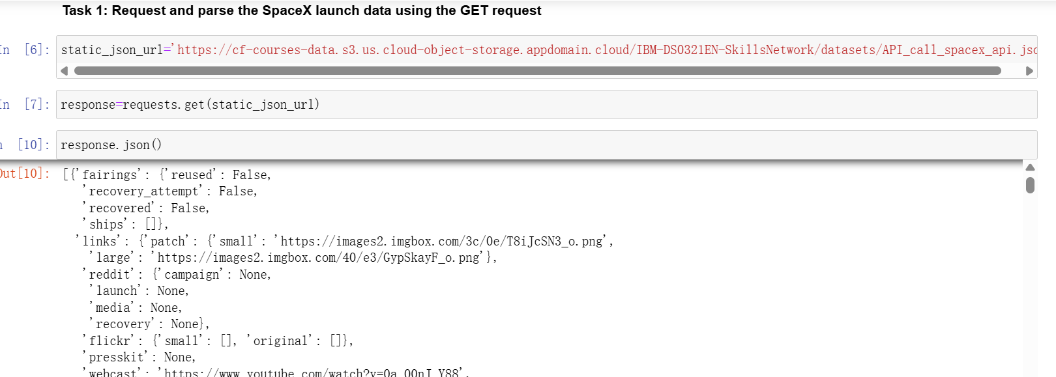
Data Collection – SpaceX API

Slide 8
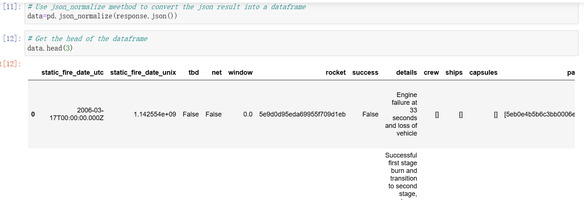
Data Wrangling
Focus on handling missing values (such as filling the payload_mass field with median) and detecting outliers (such as identifying engine thrust outliers through boxplots).
Pandas code snippets for key cleaning steps,
such as ` df. dropna (subset=['landing_outcome '])

Slide 9
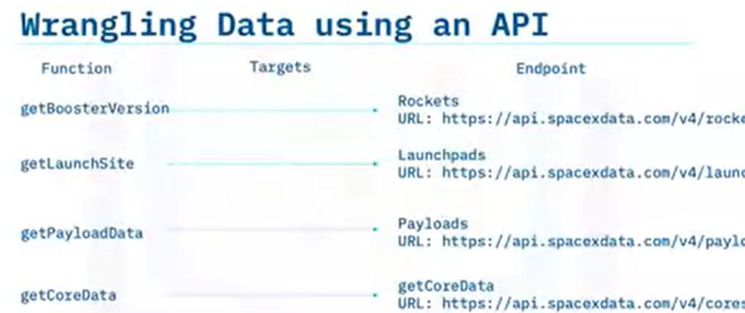
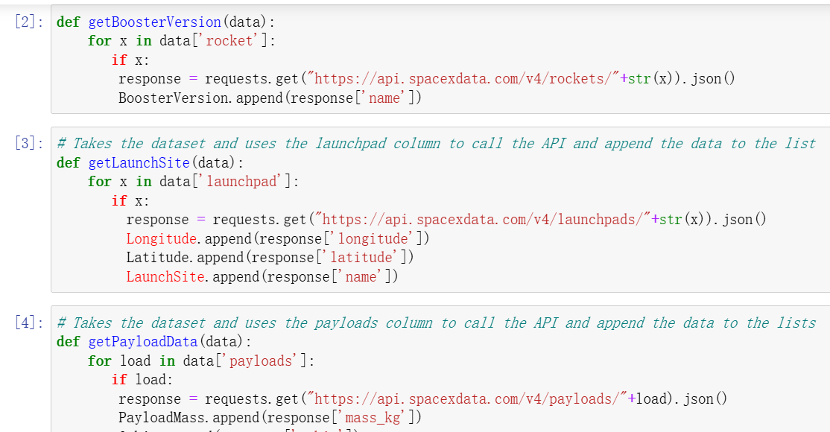
Data Wrangling

Slide 10
EDA with Data Visualization
Summarize what charts were plotted and why you used those chart

Slide 11
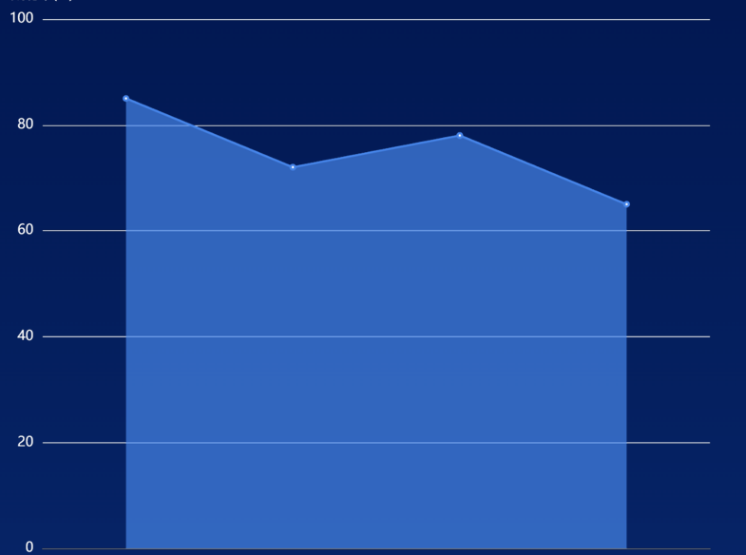
Success Rate vs. Launch Site
Compare the success rates of different locations such as the Kennedy Space Center, it was found that it had the highest success rate.
Success
Rate
Kennedy Vandenberg Cape Other
Space air force Canaveral Sites
Center base

Slide 12
Build a Dashboard with Plotly Dash
Build an interactive dashboard using Plotly Dash to display launch site maps and success rate heat maps, and provide dynamic demonstration screenshots of real-time prediction of input parameters.

Slide 13
Predictive Analysis (Classification)
Model selection
Comparative logistic regression SVM、 The F1 score of models such as random forest is used to select the best performing random forest (F1=0.86).
Importance of Features
By using the feature ranking map of the random forest, identify the features that have the greatest impact on the prediction results, such as' flight number 'and' orbit type '.

Slide 14
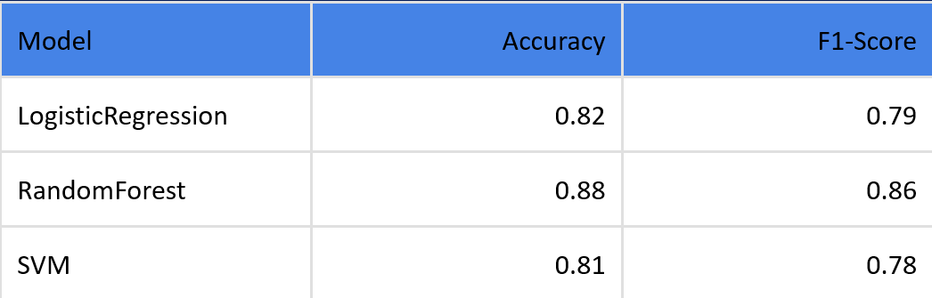
Predictive Analysis (Classification)
Cross validation
Using K-fold cross validation methods (such as sklearn. KFold) to avoid overfitting of the model and ensure its generalization ability.

Slide 15
Results
Exploratory data analysis results:
Payload_mass>10000kg and Falcon 9 launched on LC-39A, with a success rate of over 92% for the first stage landing of the rocket

Slide 16
Conclusions
Value of the project:
The model can effectively help startups evaluate risks in rocket launch bidding, and is expected to reduce related bidding costs by 30%.
Limitation:
The data of the current model is time sensitive (up to 2023), and improvements such as adding real-time meteorological features can be made in the future.
…

Slide 17


